Slide 1
Dawson
C O L L E G E
Evaluation of Neonatal Brain Tissue Development Using Diffusion MRI
(An Introduction To Python-based Medical Image Analysis)
Kylie Xu, Sara Hernandez, Erjun Zhang, Benjamin De Leener, Gregory Lodygensky
Dawson College
Neuropoly Lab, Polytechnique Montreal
CHU Sainte-Justine Research Center
August 15th, 2023
CHU Saint-Justine Summer Internship Conference (2023)
Notes:
Say Institution and lab

Slide 2
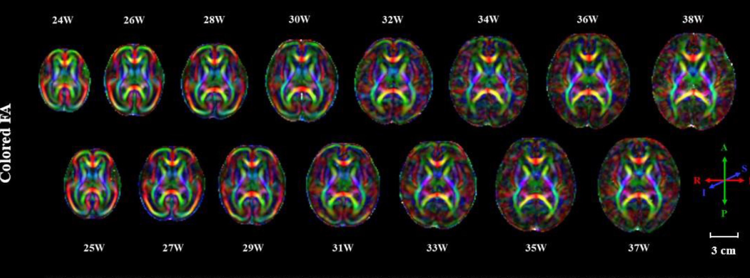
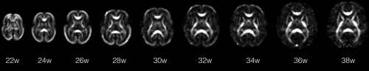
Introduction
Infant development
Brain volume growth¹
Preterm infants are at a higher risk of developing neurological conditions²
dMRI is useful to understanding brain tissue growth
¹Rebecca C. Knickmeyer, et al., 2008
²Serena J. Counsell, et al., 2008
³Chen2022-yo
⁴Khan2019-rj

Slide 3
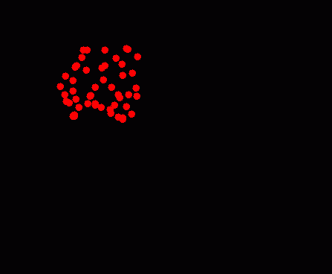
Introduction
Diffusion MRI
Non-invasive imaging technique¹
Helps us understand white matter integrity in infants²
Predicts the diffusivity direction along the white matter fiber tracks²
Problem
Little Python resources exist for beginners to access diffusivity in brain tissues
¹Hans H. Shild., 1990
²Bryon A. Muelle, et al., 2015
https://cronodon.com/BioTech/Diffusion.html
Notes:
https://cronodon.com/BioTech/Diffusion.html (gif image)

Slide 4
Goal
Learn Python coding
Write DTI reconstruction code with Python
Understanding the brain development in infants
Democratize the knowledge

Slide 5
Hypothesis
Baby development could be characterized by a difference in diffusion MRI (DTI metrics)
What we expect
Brain fibers in neonatal will mature over time and increase in anisotropic diffusion (FA value).
AD, RD and MD metrics will decrease with gestational age

Slide 6
Method
Data acquisition
Online dataset (dHCP)
45 participants (9 groups)
Scanned from 34 to 42 weeks*
Diffusion MRI (dMRI)
Scanned post-birth
Preterm babies (< 37 weeks*): 22
Term babies (≥ 37 weeks*): 23
* Every week is referred to as gestational age
Notes:
Mention how many babies in each group

Slide 7
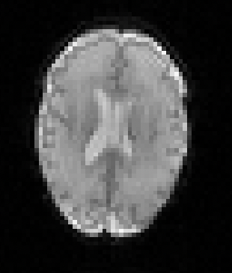
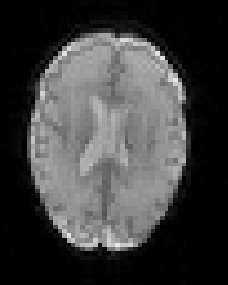
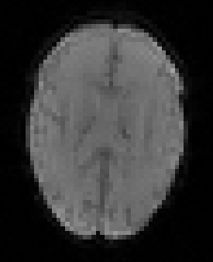
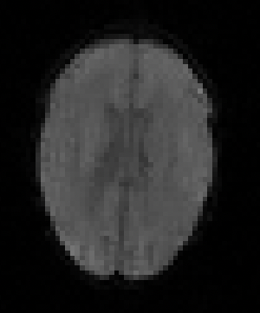
Method
Diffusion-Weighted Images (DWIs)
b0
b400
b1000
b2600
* sub-B037S1, 30 weeks (birth age), 33 weeks (scan age)

Slide 8
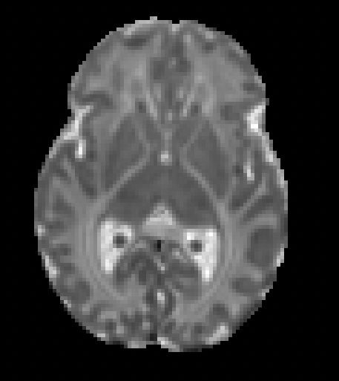
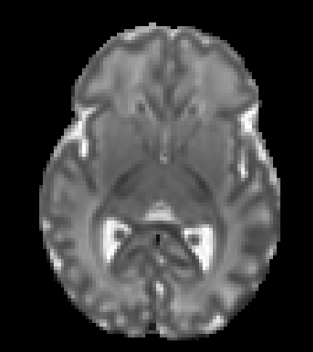
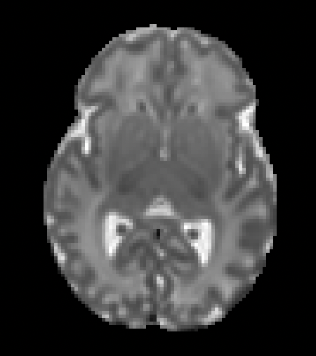
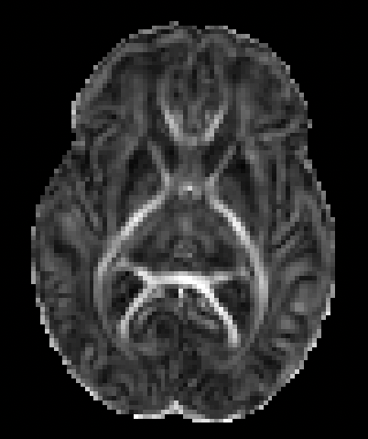
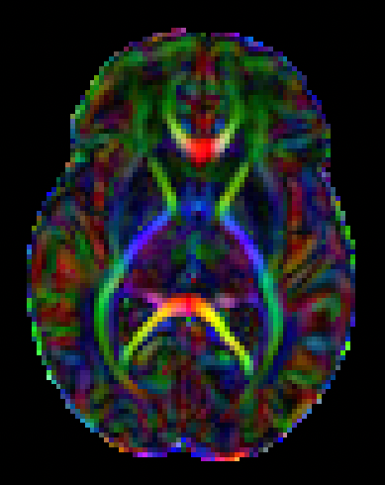
Method
Diffusion Tensor Imaging reconstruction
AD
RD
MD
FA
Colored FA
Diffusivity along the fiber
Diffusivity ⊥ to the fibers
Mean diffusion in all directions
Primary fiber bundles
Diffusivity direction
* sub-CC00063AN06, 35.1 weeks (birth age), 35.7 weeks (scan age)
Notes:
Say that it has been done with a code based on Dipy (Python library)

Slide 9
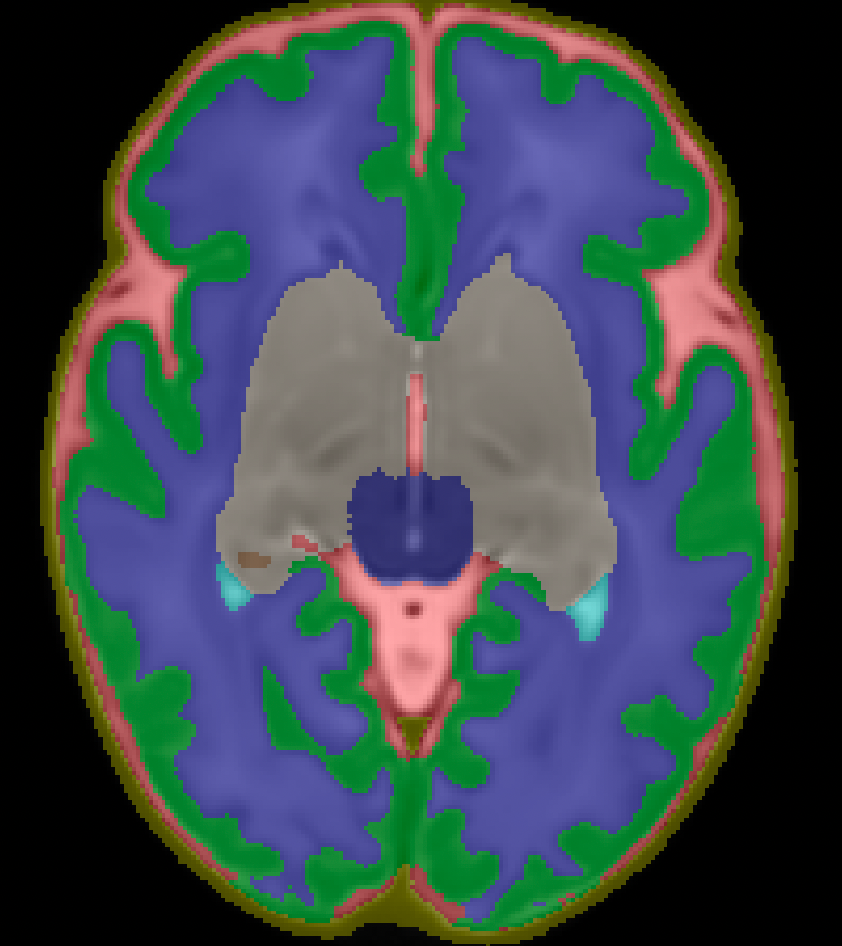
Method
Region of interests (ROIs)
Cortical gray matter
White Matter
Deep gray matter
* dHCP atlas, 36 weeks

Slide 10
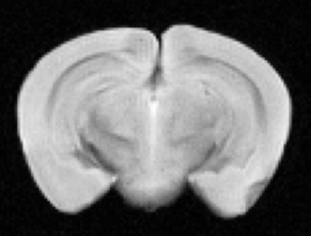
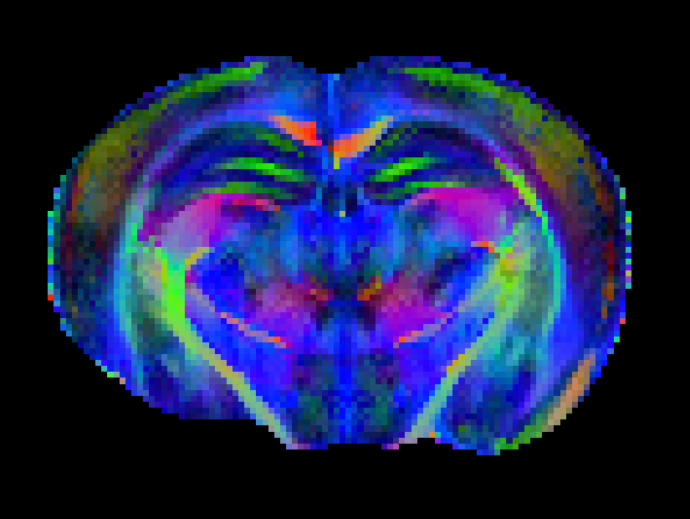
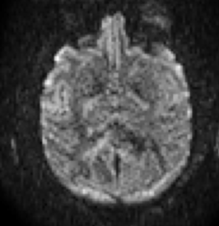
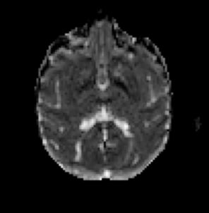
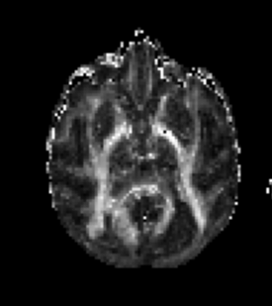
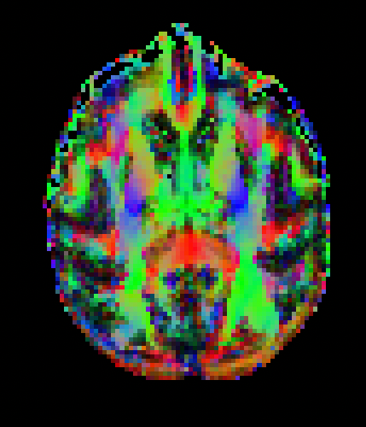
Results
DTI reconstruction
Mouse brain
Monkey brain
* Mouse data was scanned at the Montreal Heart Institute, monkey data was from open fMRI (online)

Slide 11
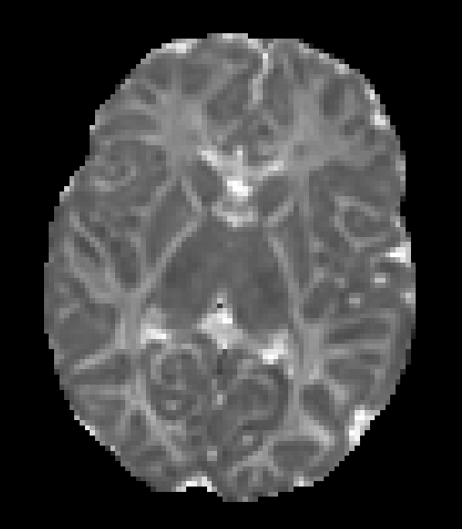
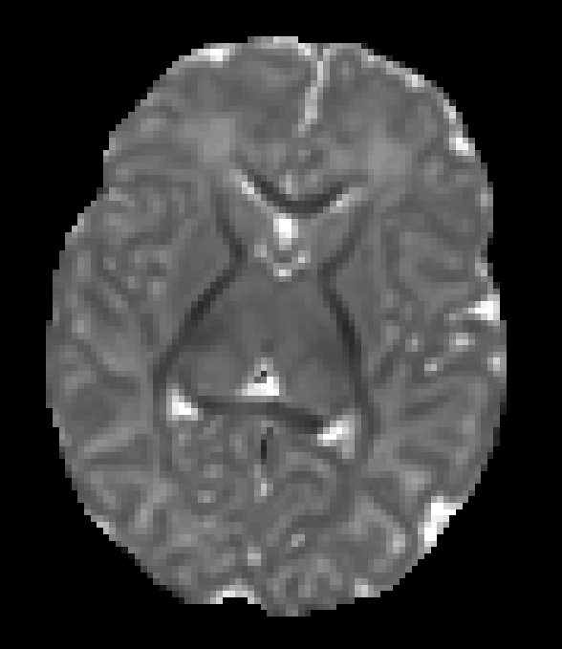
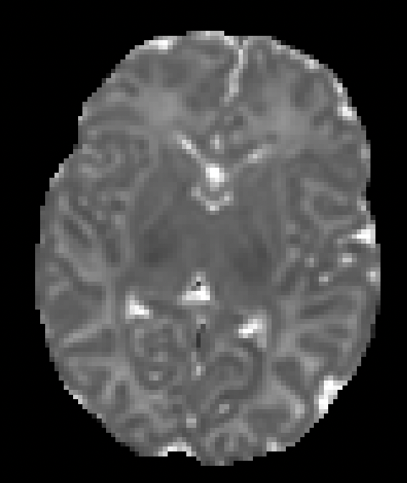
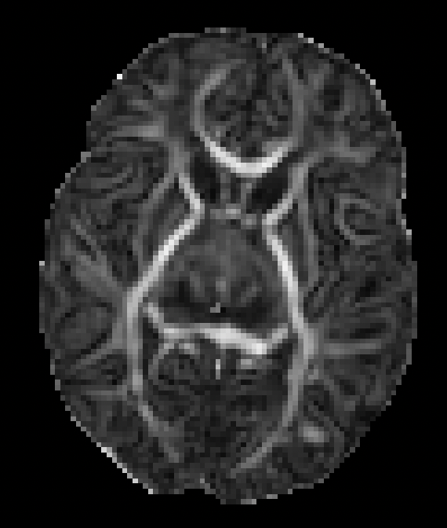
Results
DTI reconstruction
AD
RD
MD
FA
35 weeks
40 weeks
sub-CC00063AN06, 35.1 weeks (birth age), 35.7 weeks (scan age)
sub-CC00586XX18, 40.1 weeks (birth age), 40.2 weeks (scan age)

Slide 12
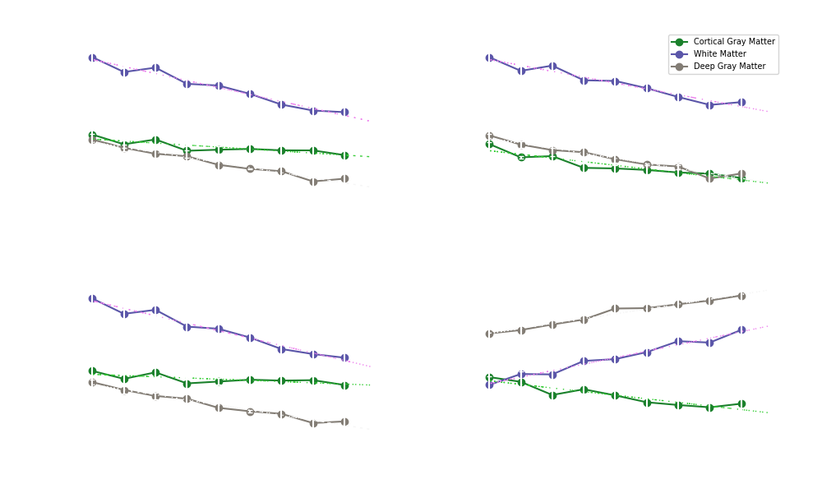
Results
Lower AD, RD and MD in white matter (WM), gray matter (GM) and deep GM
Decrease in water content
GM & WM development
Higher FA value in deep GM and WM
Increase of myelin sheet
Largest change in the white matter
Notes:
Say diffusivity instead of signal
During presentation – use pointer or arrow on slide
Change animations

Slide 13
Conclusion
Future work
dMRI can be used to access the brain tissue development
Tracking infant development
Younger babies have higher brain diffusivity compared to older babies
Older babies have higher anisotropic diffusion characterized by an increase in myelination
Different ROIs
Larger dataset
Predicting neurological conditions of infants
SCAN ME to get access to our PDF report
SCAN ME to get access to our experiment
Notes:
Say everybody can reproduce the experiment (open source, open science)

Slide 14
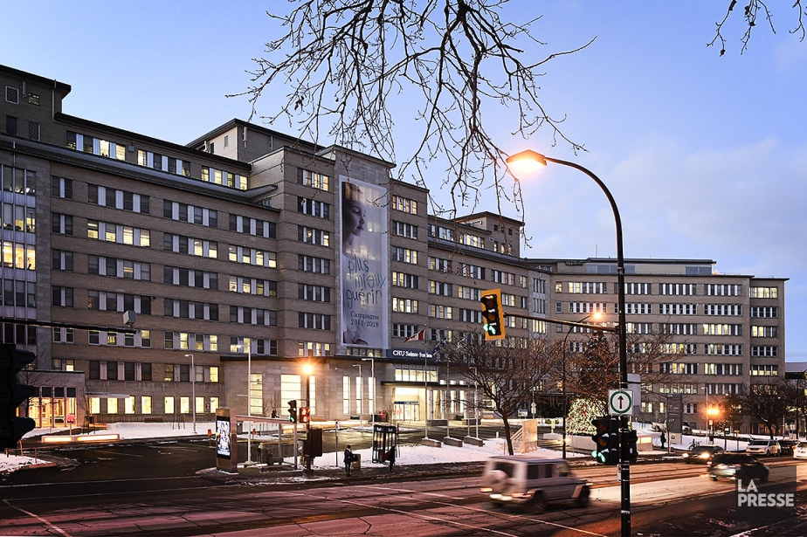
Acknowledgements
Erjun Zhang, Ph.D candidate
Dr. Benjamin De Leener, Ph.D
Dr. Gregory A. Lodygensky, MD
Michelle Poulin
Dawson
Dr. Hélène Nadeau, Ph.D
Dr. Sylvia Cox, Ph.D
C O L L E G E
Q IN
Neuro

Slide 15
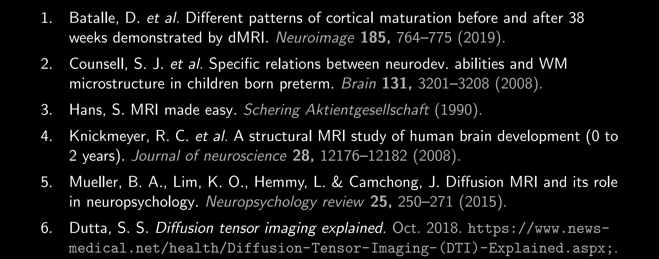
References

Slide 16
Thank you

